Slide 1

Process of Creating The Document Library

Slide 2
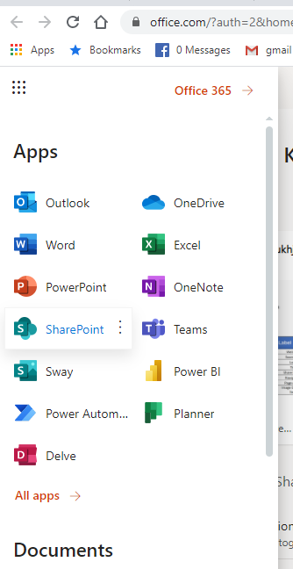
Step-1
Go to Microsoft Office 365 website
Login into your account with credentials
Choose SharePoint application from Grid View

Slide 3
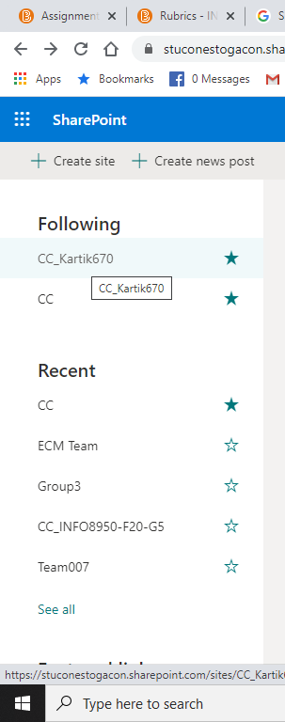
Step-2
Go to CC-(User Name) Team Site which is already
created for every individual user

Slide 4
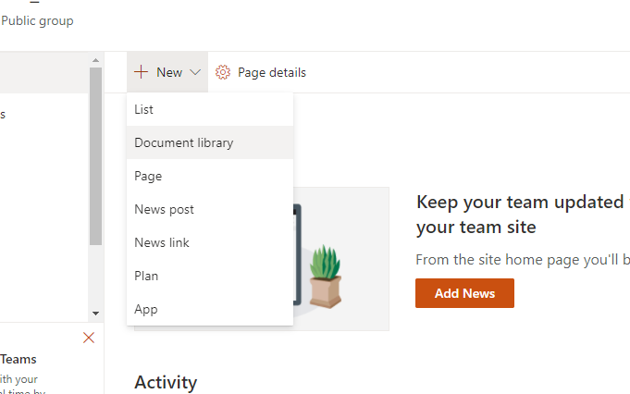
Step-3
You will be entering into the site User personal team site
Click on the new drop –down available on the top left corner of the page
Click on document Library.

Slide 5
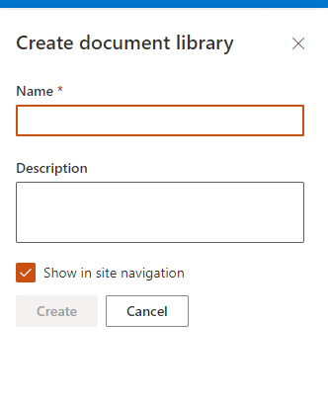
Step-4
Give the name for the document library
Add brief description about how you are going to use the library .i.e. Purpose

Slide 6
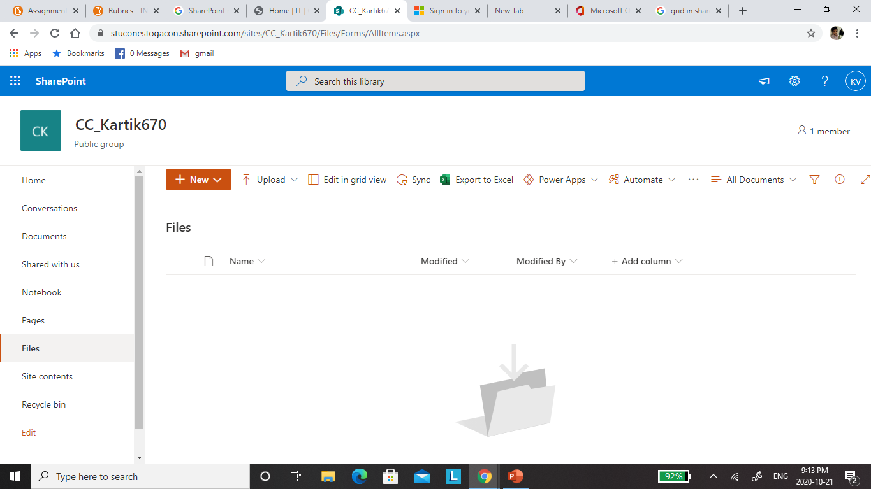
Step-5
Now you can see a page gets created for document Library

Slide 7
Success Rate
The success rate of individual user will be calculated based on the following criteria’s
By accessing the default user team site which is provided to individual user through admin portal and checking if the user has created the document library.
Handing out the checklist to the user for the feedback on document library and analysing it to evaluate the success of the learning.

